Slide 1
2019 Program Review
Presented By: Katherine Lenaburg
Notes:
We are going to take a look back at 2019 and then a look forward to what we have planned for this year with our new strategic plan.

Slide 2
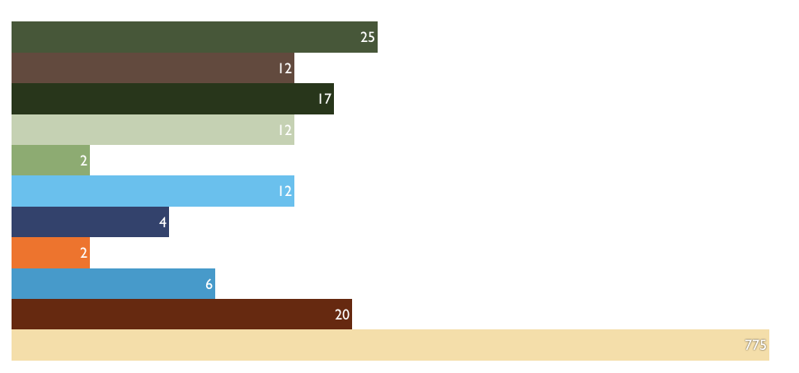
2019 City of Andover Channel Programming Stats
NUMBER OF NEW SHOWS (112)
Notes:
In Andover, we produced 112 “shows” last year. This includes city meetings- council, Planning and Zoning, and Park and Rec. Also we put the Andover version of News and Views, The Sheriff’s Show, and Public Safety Talk. We also put the Anoka County Board meetings on the channel.

Slide 3
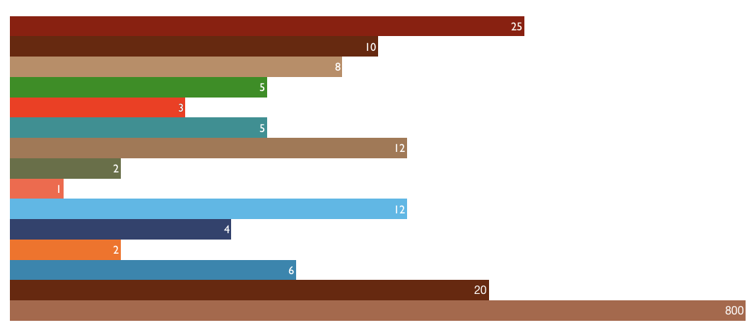
2019 city of Anoka channel programming stats
Notes:
Every city is different and in Anoka, these are the meetings we cover….

Slide 4
2019 city of Champlin Channel Programming Stats
Notes:
In Champlin, we cover these meetings.

Slide 5
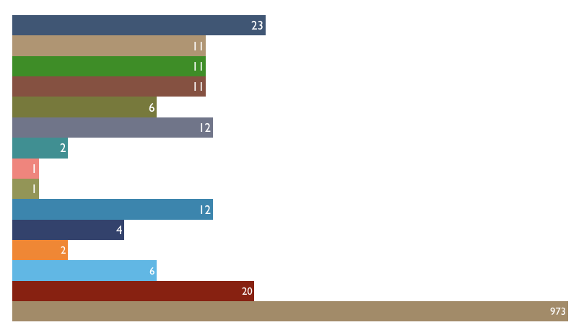
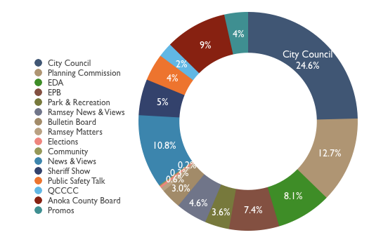
2019 City of Ramsey Channel Programming Stats
Notes:
Ramsey meetings are listed here.

Slide 6
2019 QCTV Community Channel Programming Stats
Number of New Shows (346)
Notes:
In 2019, we produced 346 shows.

Slide 7
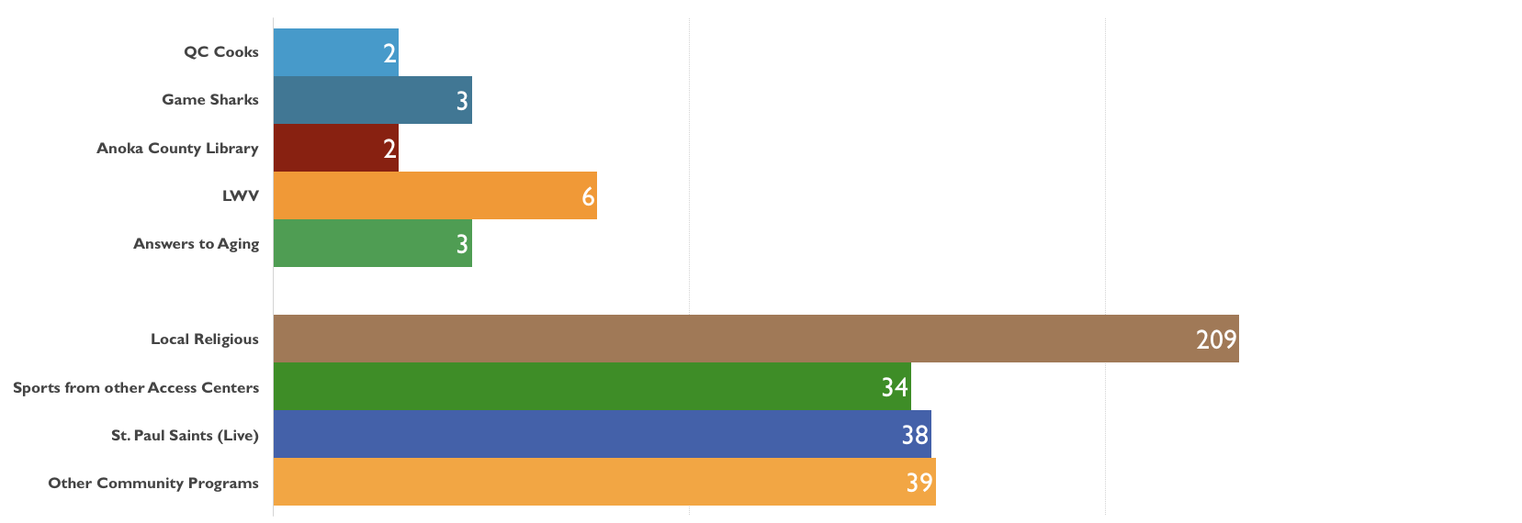
2019 QCTV Facilitated and Submitted Programming
Number of New Shows (16)
Number of New Shows (320)
Notes:
These shows at the top we call “facilitated access” which means we work with community partners- they come up with the show and host the show and we do the technical part- some times in the studio and sometimes on location.
We also play local church services and take shows from our sister stations that we think are of interest to our viewers. This collaboration goes both ways- if we do a game with Brooklyn Park, CTN may take that too.

Slide 8
2019 Election Coverage
• Special Election for Ramsey City Councilmember Ward 3
• Anoka-Hennepin School Board Districts 1, 2, and 5
Notes:
Last year was not a big election year so we just did two candidate forums.

Slide 9
Survey feedback:
“Always professional and helpful. So pleased to see you’re inclusive too.”
“Thanks for always supporting the community”
“Katherine was terrific to work with and the crew were friendly and professional”
“You are doing fantastic work! Thank you!”
“QCTV has been doing an exceptional job. I am very excited about the new changes and content ideas that will be rolling out.”
Notes:
We are proud of our relationship in the community. Probably the biggest remarks I get are: Oh Winter made it so easy for me and Cory is so nice.

Slide 10
Testimonials:
“I want to thank you for all your help with the taping today of my climate lecture, Katherine. You are a true professional from start to finish, which was helpful and reassuring to me. I am deeply grateful. I look forward to seeing the video and being able to use it to amplify my message. Best and thanks again. - Dr. Jay Coggins
“I saw you hosting a show on groundwater this weekend. A regular Chris Wallace. Great job!” – Jim January
“Thanks Katherine- It was a blast hosting The Happy Days Parade. – Scott Siebert
Thank you for covering the Anoka-Hennepin School Board Candidates Forum. All went very well! Lots of comments from attendees and appreciation for having it televised. Thanks so much. – Debbie Koffski
Thank you Katherine! I had fun hosting the Andover Fun Fest Parade. Your crew is awesome to work with! ☺ - Nichol Lehn
Notes:
We often send out our shows and get lots of thank yous back when we do. It really is customer service.

Slide 11
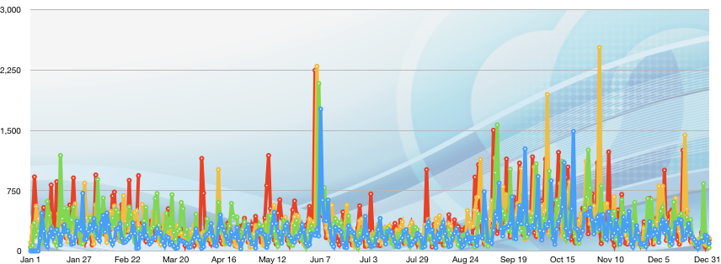
2016 - 2019 Web Statistics
Daily Pageviews per Year
2016 | 86,000
2017 | 109,170
2018 | 121,066
2019 | 123,588
Notes:
People continue to find us on our website…We have gone up over the last five years.
This big spike was a playoff game in 2018 and we didn’t have that last year.

Slide 12
2016 - 2019 Archived video Views
 | 2016 | 2017 | 2018 | 2019
Andover | 1,147 | 1,004 | 1,768 | 2,465
Anoka | 1,657 | 2,059 | 2,516 | 2,442
Champlin | 1,189 | 2,214 | 1,895 | 1,834
Ramsey | 1,107 | 1,338 | 2,045 | 2,126
Notes:
These are the times people went to our website to look at a program.

Slide 13
2019 Top Ten Web pages
Page Title
QCTV Homepage
Sports
Live Page – Community Channel
Program Guide – General
Andover
Anoka
Champlin
Ramsey
Program Guide – Community Channel
Programs
Notes:
This has been consistent too. Andover moved up on the list this past year as they had some community discussions that garnered a lot of attention.

Slide 14
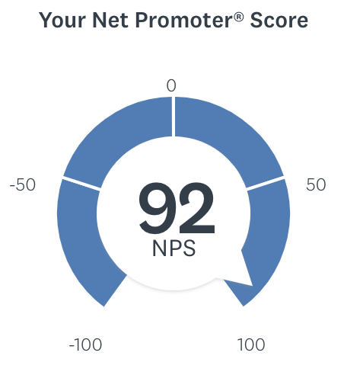
2019 (NPS®) Net Promoter Score
How likely is it that you would recommend QCTV to a friend or a colleague?
Notes:
Our net promoter score moved up to 92 from 91 and we are outperforming other organizations.

Slide 15
2019 social media
Notes:
Taylor has been really good at this with our local sports- Taylor- tell folks what you do after every game and how it works.

Slide 16
2019 Award Winning Programs:
Bronze Award- History- Gold Star Mothers- Presented by the 40th Annual Telly Awards
Bronze Award- Live Video- Live and Local: Centenary of Armistice- Presented by the 40th Annual Telly Awards
Bronze Award- Live Video- Cambridge-Isanti @ Andover Football- Presented by the 40th Annual Telly Awards
Awards of Honor- Live Sports Event- Cambridge-Isanti @ Andover Football- Presented by NATOA
Notes:
It is nice to be recognized for our work. These are national awards- Tells and NATOA.

Slide 17
Strategic plan:
Refocus Linear Channel Programming
Social Media First Strategy
ROI- Quarterly Statistic Changes
Equipment
Notes:
Now we are going to talk about our new 5 year strategic plan. (Hand out). This is our road map for what we have been planning. The direction we are going in.

Slide 18
Strategic plan:
Engaging the Community
Update programming content to engage the community
Leverage community partners for programming
Notes:
These are Year One Objectives we have been working on. We have good relationships with our four member cities, the local police and fire departments, The Sheriff’s Office, schools, and business community. These relationships are great assets for us as we go forward. So I have done a series of meetings with the cities of Champlin, Anoka, and Ramsey- I have met with their communication managers to dee what their reaction is to our new plans. They want us to do what we have been doing and promote their programs through social media. They like the idea of social media first. It is the direction they are going and they welcome content from us.

Slide 19
Strategic plan:
Collaborating for Success
Foster collaborative working relationships between QCTV and city staff
Notes:
So I have done a series of meetings with the cities of Champlin, Anoka, and Ramsey- I have met with communication managers Pam Bowman and Megan Thorstad and Roberta Colotti to see what their reaction is to our new plans. They want us to do what we have been doing and promote their programs through social media. They like the idea of social media first. It is the direction they are going and they welcome content from us. They like this idea and have requested we tag them in Facebook posts, for example.

Slide 20
Strategic plan:
Innovating for Impact
Identify community needs and assess engagement
Diversify distribution platforms
Notes:
We have also been working with the local school district and we plan to do short pieces on school programs. (Hand out monthly report for social media examples) Jim Skelly has been very helpful and we are talking about Student of the Month, and they are excited for future stories. We are working on another objective which is an intern program and I met with Scott Storrick who is the internship coordinator at Coon Rapids High School and they have a program where they place students in manufacturing jobs and they want to expand to communications and video production. We are going to draft a policy and job description for an intern program.
We are still planning on the diversification of platforms but what success looks like is that we want to be everywhere- YouTube, twitter, Facebook, our channel and website. That is what CCX does and they are a real success story. Karen ?

Slide 21
Strategic plan
Refocus Linear Channel and Long Form Programs
The Chamber Show
The District Court Show
Anoka County Library Shows
At the Half
QC Cooks
Answers to Aging
Game Sharks
Government Meetings
City Matters
Election Coverage
Parades and Community Events
Graduations
Local Sports
LWV Shows
Live and Local
Notes:
We still want to program our channel and so we will produce these shows they way we have been producing the. These include our core services- government meetings, parades and community events, election coverage, and local sports which is very popular.

Slide 22
Strategic plan
Social Media First Strategy:
Public Safety Talk
The Sheriff’s Show
News and Views
The Grid
The Local Show
It’s Your History
Let’s Go To The Library
Transitioning from long format to Social Media First Strategy
Starts with how we produce content
Notes:
These shows we are going to transition to social media first. This means instead of a long show, you will see shorter stories. We are committed to our community partners and in an asset based approach, they are very important. The Ramsey Fire Chief Matt Kohner has great ideas for Public Safety Talk- he want to do several short pieces like Fire Prevention Week, in one day, We have met with Rebecca of The Historical Society and are working on the first five one minute segments.

Slide 23
Strategic plan
“News and Views”
Monthly Hour Show
8-Five Minute Interviews with City Council Members and Staff
8- One and One Half Minute Packages
Long Lead Time
“The Post”
Live Weekly Show
Live One Minute Report from the Field
QCTV Host and Community Co-Host
3-4 One Minute Stories
Five Social Media Posts
Leverage Engagement Through Tagging Partners
Notes:
N and V has worked well for us but with our new direction, we have come up with a place for these shorter stories. A live weekly show we are calling The Post. Segments will rotate but they will come from our cities and what they want to promote, The Police Dept. wants to promote their events like Coffee with a Cop, Night to Unite, Off the Clock, What’s My Job, Student of the Week, What’s For Lunch, Why I Serve. Our community co-hosts will be mayors, city council members, business leaders, non-profit folks and they will get a chance to promote their passion projects. Our QCTV co-host will interview them between introducing the live shot and packages. Wednesday at 2pm we will do the show live show- which will go on our channel, website, and YouTube and then we will redeploy five social media posts and tag our partners.

Slide 24
The Post
Notes:
Here is an example of a minute story.

Slide 25
Return on investment (ROI)
Quarterly Stats:
Number of Programs Produced
Tracked Linear Channel Playback Time
Showed Overall Website Traffic
Continue Tracking Number of Programs Produced
Social Media Analytics
Highlight Posts with Engagement
Continue Tracking Website Traffic
Notes:
Op Report stats

Slide 26
EQUIPMENT
Mobile Production Truck
Four Checkout Cameras
Studio
Mobile Media Investment
Smart Phones
Live Backpack (LiveU, Comrex, etc.)
Studio Set
Drone
+
Notes:
Karen

Slide 27
Action steps
Consultant Contract
Set Design and Construction
Mobile Equipment
Notes:
Karen

Slide 28
Our Commitment to the Mission
Our appreciation to the commission
for their vision and strategic plan.
Staff is committed to delivering quality programming for our member cities.

Slide 29
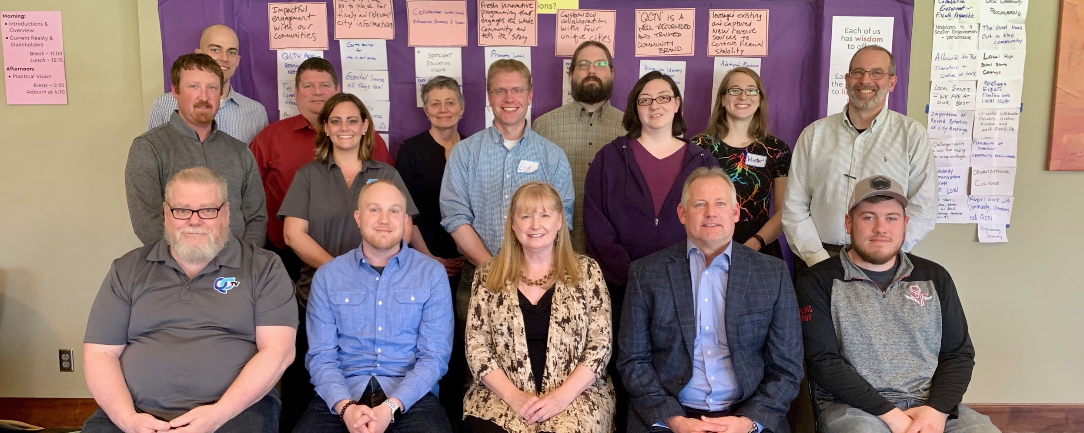
Our Amazing Staff
Notes:
That’s us!

Slide 30
Commission Discussion
Comments Regarding Presentation

